Slide 1
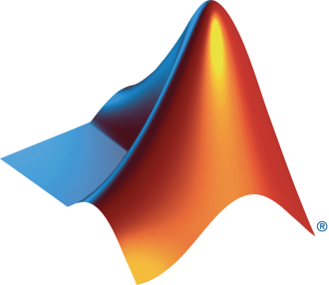
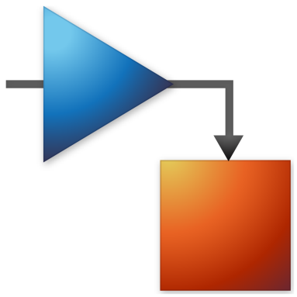
HPRC and MathWorks Present: Signal Processing Onramp

Slide 2
Today:
6:15 pm – 6.30 pm: Set-up
Intro to Deep Learning
Create MathWorks account
Log in to Deep Learning Onramp / Test MATLAB Online
6.30 pm – 8.00 pm: Deep Learning Onramp (on your own)

Slide 3


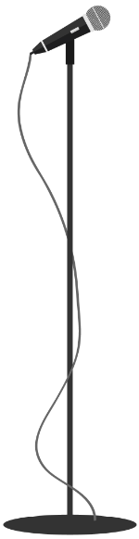
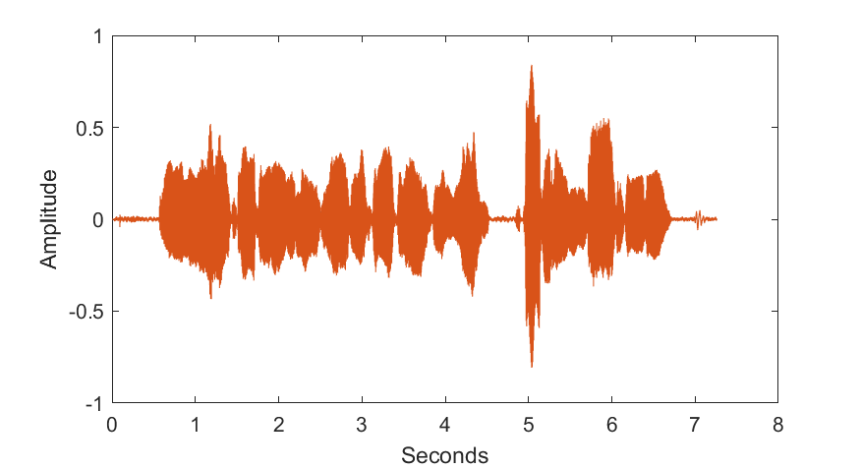
Signals
A function that describes data about a physical phenomena
Examples:
Sounds
Images
Sensors
Light sensor
Proximity sensor
Pressure Sensor

Slide 4
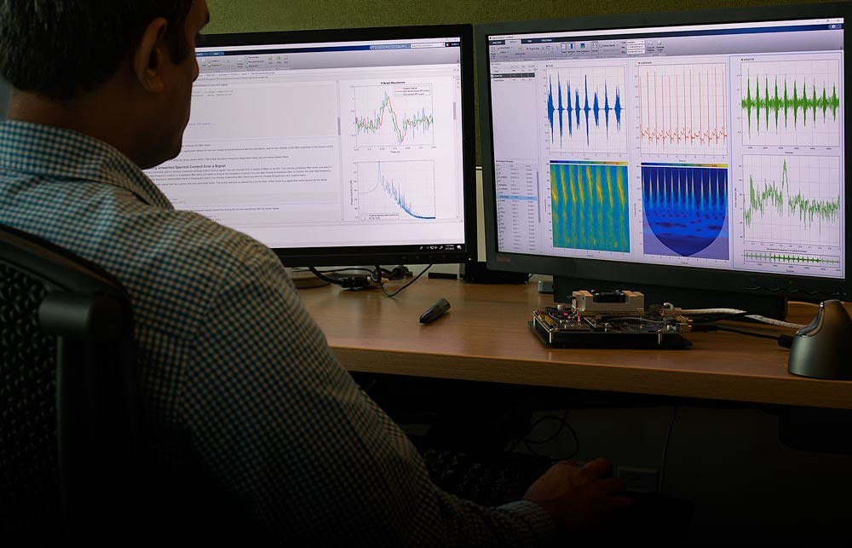
Signal processing
Field of modifying and synthesizing signals to get desired results
Signals are often companied by noise – unwanted modifications to signal
Mathematical operations performed to remove noise or amplify signal

Slide 5
Signal Processing Workflow
Pre-process
Analyze
Filter

Slide 6
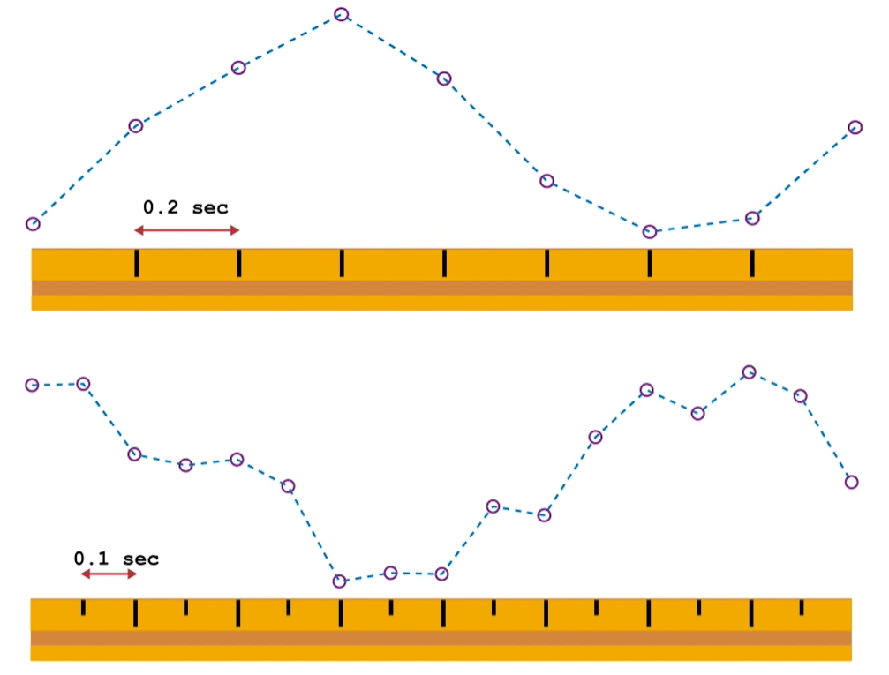
Pre-process
Imported signals often aren’t perfect - Irrelevant trends and noise can be found
When comparing two signals, they must match:
Sample time
Time steps
Time range

Slide 7
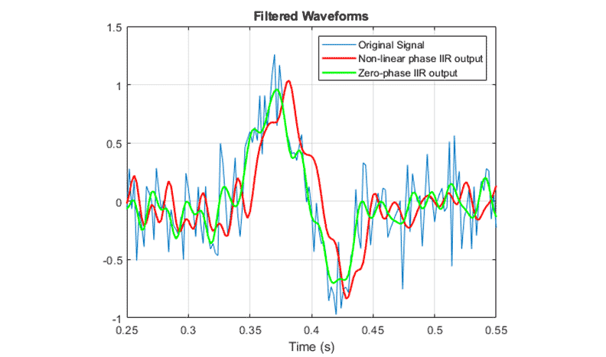
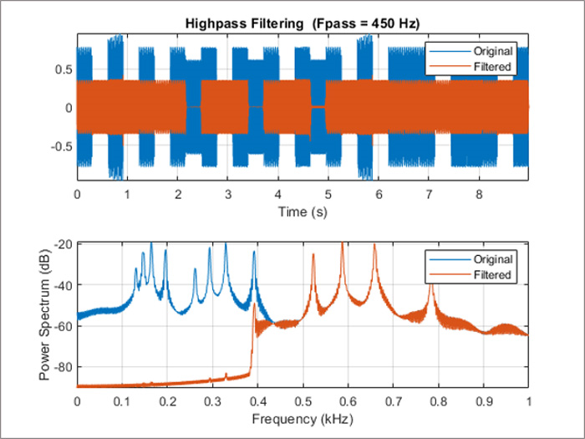
Filtering
To analyze the signal of interest, filters may have to be applied to isolate or amplify the signal
Low/high pass filter
Zero-Phase Filter
Phase filter
Finite impulse response filter
Etc.

Slide 8
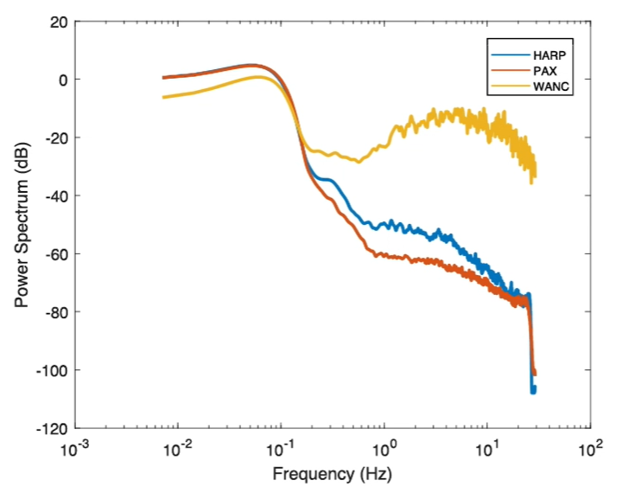
Analyze
Signals are often made up of different frequencies
Power Spectrum vs. Frequency is a common way for examining frequencies in a signal
Fourier transform is used find the frequencies in a signal

Slide 9
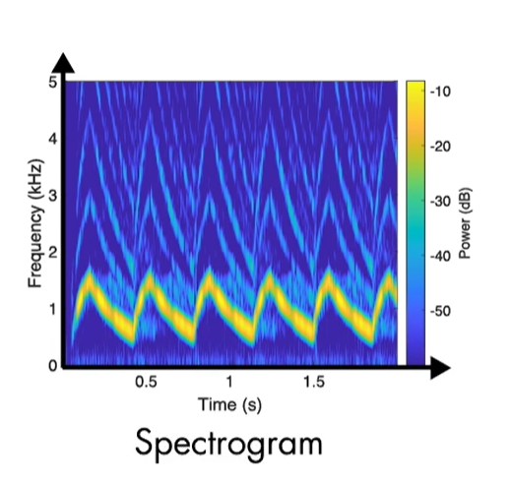
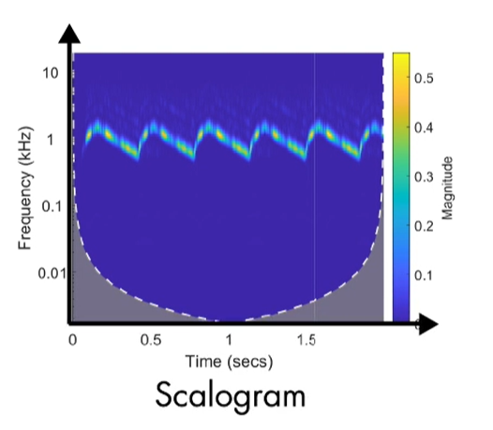
Analyze
Amplitude-time and power-frequency plots don’t provide a lot of information on their own
Time-frequency plots should be used to analyze full spectrum of signal
Spectrogram: Fourier
Scalogram: Wavelets

Slide 10
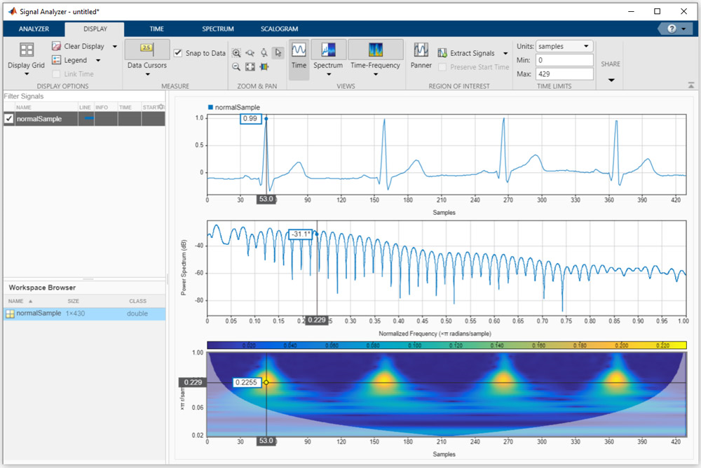
Signal Processing in MATLAB
Signal Processing Toolbox provides functions and apps that allow you to:
Label signals with attributes, regions, and points of interest
Preprocess and analyze multiple signals simultaneously in time, frequency, and time-frequency domains
Design and analyze digital filters by choosing from a variety of algorithms and responses

Slide 11
How can signal processing be used in the real world?

Slide 12
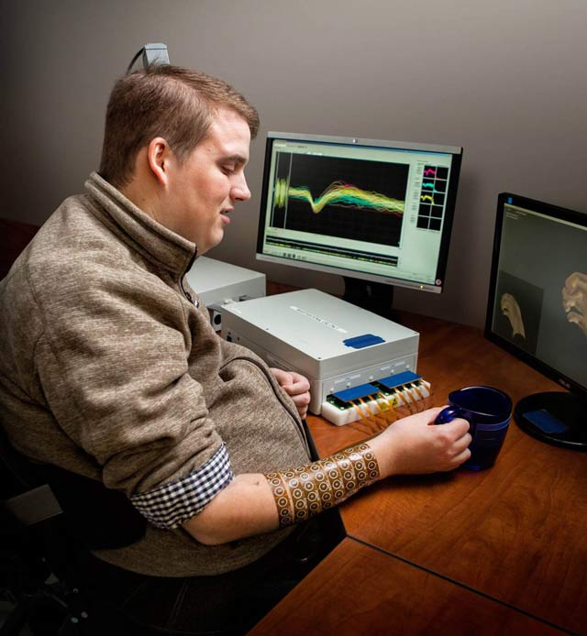
Battelle Neural Bypass Technology Restores Movement to a Paralyzed Man’s Arm and Hand
Challenge
Restore arm and hand control to a quadriplegic man by processing signals from an electrode array implanted in his brain
Solution
Use MATLAB to analyze signal samples, apply machine learning to classify patterns mapped to movements, and generate actuation signals for a neuromuscular electrical stimulator
Results
Control over paralyzed hand and arm restored
Real-time processing performance achieved
Interdisciplinary collaboration enabled
Patient using the Battelle NeuroLife system.
“The algorithms we developed using MATLAB gave the participant back basic control of his arm and hand. By the end of the study, he could grip a bottle, pour out its contents, and set it down, as well as pick up a stir stick and execute a stirring motion.” - David Friedenberg, Battelle
Link to user story
Notes:
Industries: Medical Devices
Application Areas: Data analytics, Digital signal processing
Capabilities: Data analysis, Algorithm development, Machine learning
Products Used: MATLAB, Wavelet Toolbox
Country: USA
Battelle Neural Bypass Technology Restores Movement to a Paralyzed Man’s Arm and Hand
When disease or injury disrupts the neural pathways connecting the brain’s motor cortex to muscles, the result is often permanent paralysis. A team of engineers, scientists, and statisticians at Battelle have developed a technology that bypasses damaged neural pathways. Known as Battelle NeuroLife™, the system is the first ever to successfully restore muscle control using intracortically recorded neural signals in a human. It has enabled a quadriplegic man to regain control of his right forearm, hand, and fingers.
NeuroLife includes signal processing and machine learning algorithms developed in MATLAB®. These algorithms process and interpret signals from a microelectrode array implanted in the study participant’s brain. When the participant thinks of a specific hand movement, the algorithms decode the resultant brain signals, identify the intended movement, and generate signals that stimulate the patient’s arm to perform the movement.”
Challenge
Neurosurgeons from The Ohio State University Wexner Medical Center implanted a microelectrode array into the volunteer participant’s left primary motor cortex. The array uses 96 individual electrodes to record neural activity. At 30,000 samples per second, the electrodes produce almost 300,000 samples every 100 milliseconds.
To translate this data into specific hand movements, Battelle engineers needed to extract meaningful features, apply classification algorithms to identify patterns in those features, and map the patterns to the participant’s intended hand movements. The engineers then needed to control 130 channels of a neuromuscular electrical stimulator (NMES) sleeve on the participant’s right arm. Even a seconds-long delay between thought and movement would have made the movement too unnatural, rendering the entire system impractical. As a result, all data processing, classification, and decoding had to be done in real time. To achieve performance approaching natural motion, the system had to update 10 times per second, which meant completing all processing steps in less than 100 milliseconds.
“The algorithms we developed using MATLAB gave the participant back basic control of his arm and hand. By the end of the study, he could grip a bottle, pour out its contents, and set it down, as well as pick up a stir stick and execute a stirring motion.”
- David Friedenberg, Battelle
Solution
Battelle used MATLAB to develop signal processing and machine learning algorithms and run the algorithms in real time.
The participant was shown a computer-generated virtual hand performing movements such as wrist flexion and extension, thumb flexion and extension, and hand opening and closing, and instructed to think about making the same movements with his own hand.
Working in MATLAB, the team developed algorithms to analyze data from the 96 channels in the implanted electrode array. Using Wavelet Toolbox™, they performed wavelet decomposition to isolate the frequency ranges of the brain signals that govern movement.
They performed transforms on the results of the decomposition in MATLAB to calculate mean wavelet power (MWP), reducing the 3000 features captured during each 100 millisecond window for a single channel to a single value.
The resulting 96 MWP values were used as feature vectors for machine learning algorithms that translate the features into individual movements.
The team used MATLAB to test several machine learning techniques, including discriminant analysis and support vector machines (SVM), settling on a custom SVM optimized for performance.
During testing sessions, the team trained the SVM by having the participant attempt the movements shown in the videos. They used the trained SVM’s output to animate a computer-generated virtual hand that the participant could manipulate on screen. The same SVM output was scaled and used to control the 130 channels of the NMES sleeve.
While the participant moved his arm and hand to perform simple movements, all signal processing, decoding, and machine learning algorithms were run in MATLAB in real time on a desktop computer.
Battelle engineers are currently using MATLAB to develop algorithms for the second- generation NeuroLife system, which will incorporate accelerometers and other sensors to enable the control algorithms to monitor the position of the arm and detect fatigue.
Results
■ Control over paralyzed hand and arm restored. “The algorithms we developed using MATLAB to decode signals from an implanted microelectrode array and actuate an NMES sleeve gave the participant back basic control of his arm and hand,” says David Friedenberg, principal research statistician at Battelle. “By the end of the study, he could grip a bottle, pour out its contents, and set it down, as well as pick up a stir stick and execute a stirring motion.”
■ Real-time processing performance achieved. “Our algorithms performed all the necessary wavelet decomposition, decoding, and other processing within 60–70 milliseconds running in MATLAB,” says Nick Annetta, research scientist at Battelle.”
■ Interdisciplinary collaboration enabled. “I’m a statistician, Nick is an electrical engineer, and lots of other engineers and interns worked on the project,” says Friedenberg. “The whole team was comfortable with MATLAB—it was the language that we all had in common.”
Learn more Battelle: www.battelle.org/neurolife

Slide 13
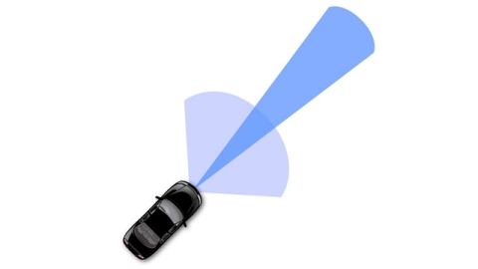
Delphi Develops Radar Sensor Alignment Algorithm for Automotive Active Safety System
Challenge
Deliver a production automotive radar sensor alignment algorithm in four weeks
Solution
Adopted MATLAB to develop and implement a radar sensor alignment algorithm that calculates sensor misalignment angles from raw radar detection and host vehicle speed.
Results
Generated C code as efficient as handwritten C code for this algorithm
Algorithm changes easily verified and coded in seconds
“MATLAB is my preferred tool because it speeds algorithm design and improvement. I can do the data analysis, algorithm development, algorithm visualization, and simulation in one place and then generate C code that is reliable, efficient, and easy for software engineers to integrate within a larger system.”
Liang Ma, Delphi
Link to user story
Notes:
Industries: Medical Devices
Application Areas: Data analytics, Digital signal processing
Capabilities: Data analysis, Algorithm development, Machine learning
Products Used: MATLAB, Wavelet Toolbox
Country: USA
Battelle Neural Bypass Technology Restores Movement to a Paralyzed Man’s Arm and Hand
When disease or injury disrupts the neural pathways connecting the brain’s motor cortex to muscles, the result is often permanent paralysis. A team of engineers, scientists, and statisticians at Battelle have developed a technology that bypasses damaged neural pathways. Known as Battelle NeuroLife™, the system is the first ever to successfully restore muscle control using intracortically recorded neural signals in a human. It has enabled a quadriplegic man to regain control of his right forearm, hand, and fingers.
NeuroLife includes signal processing and machine learning algorithms developed in MATLAB®. These algorithms process and interpret signals from a microelectrode array implanted in the study participant’s brain. When the participant thinks of a specific hand movement, the algorithms decode the resultant brain signals, identify the intended movement, and generate signals that stimulate the patient’s arm to perform the movement.”
Challenge
Neurosurgeons from The Ohio State University Wexner Medical Center implanted a microelectrode array into the volunteer participant’s left primary motor cortex. The array uses 96 individual electrodes to record neural activity. At 30,000 samples per second, the electrodes produce almost 300,000 samples every 100 milliseconds.
To translate this data into specific hand movements, Battelle engineers needed to extract meaningful features, apply classification algorithms to identify patterns in those features, and map the patterns to the participant’s intended hand movements. The engineers then needed to control 130 channels of a neuromuscular electrical stimulator (NMES) sleeve on the participant’s right arm. Even a seconds-long delay between thought and movement would have made the movement too unnatural, rendering the entire system impractical. As a result, all data processing, classification, and decoding had to be done in real time. To achieve performance approaching natural motion, the system had to update 10 times per second, which meant completing all processing steps in less than 100 milliseconds.
“The algorithms we developed using MATLAB gave the participant back basic control of his arm and hand. By the end of the study, he could grip a bottle, pour out its contents, and set it down, as well as pick up a stir stick and execute a stirring motion.”
- David Friedenberg, Battelle
Solution
Battelle used MATLAB to develop signal processing and machine learning algorithms and run the algorithms in real time.
The participant was shown a computer-generated virtual hand performing movements such as wrist flexion and extension, thumb flexion and extension, and hand opening and closing, and instructed to think about making the same movements with his own hand.
Working in MATLAB, the team developed algorithms to analyze data from the 96 channels in the implanted electrode array. Using Wavelet Toolbox™, they performed wavelet decomposition to isolate the frequency ranges of the brain signals that govern movement.
They performed transforms on the results of the decomposition in MATLAB to calculate mean wavelet power (MWP), reducing the 3000 features captured during each 100 millisecond window for a single channel to a single value.
The resulting 96 MWP values were used as feature vectors for machine learning algorithms that translate the features into individual movements.
The team used MATLAB to test several machine learning techniques, including discriminant analysis and support vector machines (SVM), settling on a custom SVM optimized for performance.
During testing sessions, the team trained the SVM by having the participant attempt the movements shown in the videos. They used the trained SVM’s output to animate a computer-generated virtual hand that the participant could manipulate on screen. The same SVM output was scaled and used to control the 130 channels of the NMES sleeve.
While the participant moved his arm and hand to perform simple movements, all signal processing, decoding, and machine learning algorithms were run in MATLAB in real time on a desktop computer.
Battelle engineers are currently using MATLAB to develop algorithms for the second- generation NeuroLife system, which will incorporate accelerometers and other sensors to enable the control algorithms to monitor the position of the arm and detect fatigue.
Results
■ Control over paralyzed hand and arm restored. “The algorithms we developed using MATLAB to decode signals from an implanted microelectrode array and actuate an NMES sleeve gave the participant back basic control of his arm and hand,” says David Friedenberg, principal research statistician at Battelle. “By the end of the study, he could grip a bottle, pour out its contents, and set it down, as well as pick up a stir stick and execute a stirring motion.”
■ Real-time processing performance achieved. “Our algorithms performed all the necessary wavelet decomposition, decoding, and other processing within 60–70 milliseconds running in MATLAB,” says Nick Annetta, research scientist at Battelle.”
■ Interdisciplinary collaboration enabled. “I’m a statistician, Nick is an electrical engineer, and lots of other engineers and interns worked on the project,” says Friedenberg. “The whole team was comfortable with MATLAB—it was the language that we all had in common.”
Learn more Battelle: www.battelle.org/neurolife

Slide 14
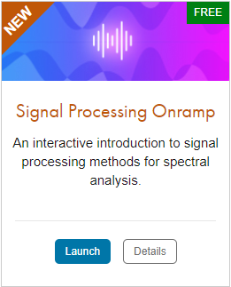
TO DO
Go to https://matlabacademy.mathworks.com/
Log in to your MathWorks account
Launch Signal Processing Onramp

Slide 15
Prizes
Complete at least 50% of Signal Processing Onramp to be eligible for any prize
Bring your laptop when you come to collect the prize
Follow Us on Facebook!
Find us on Facebook at [Insert Facebook Group Name]

